Slide 1
Group work, aaaahhhh
Naomi Alterman // UW eScience Institute
7/13/21

Slide 2

Collaboration is beautiful and hard
Within a collaborative dynamic, some of us are pointy and some of us are round
It’s easy to needle each other, even without knowing it
Highly context dependent

Slide 3
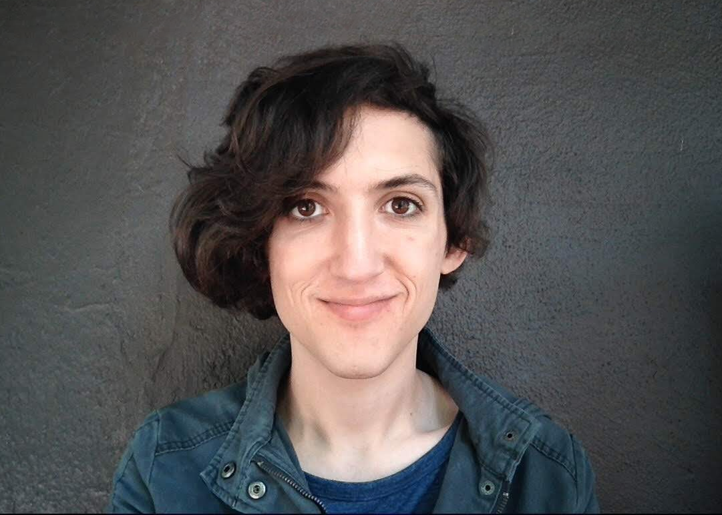
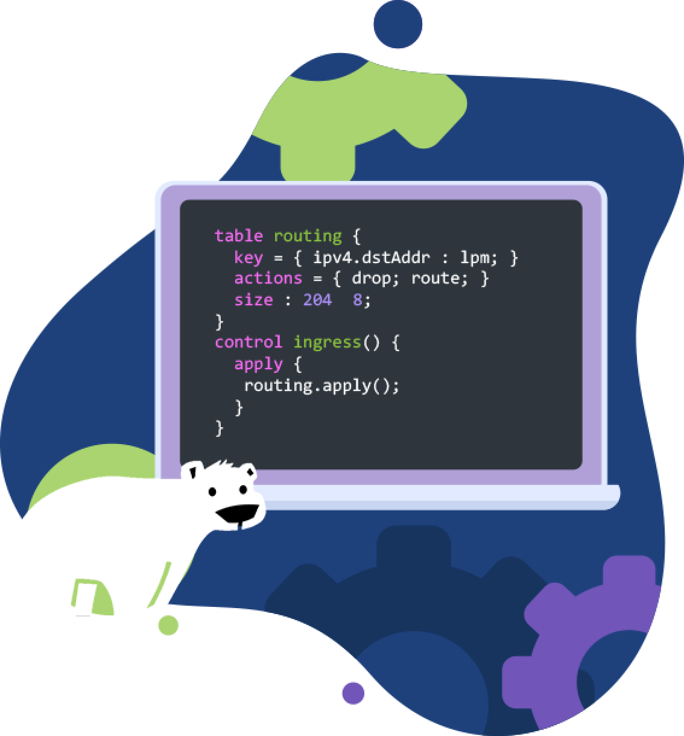
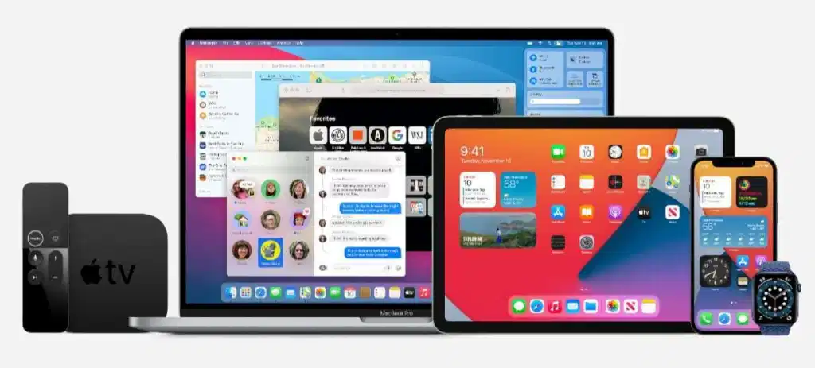
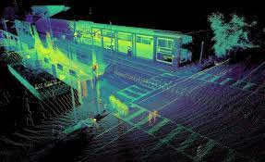
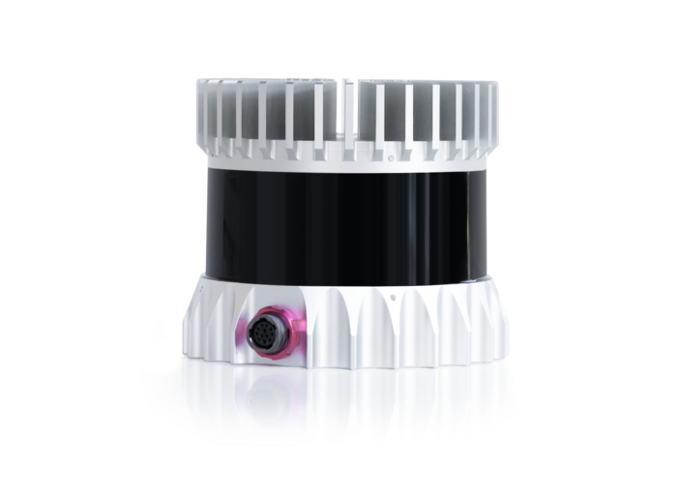

Slide 4
Data Science Hackathon
December 2018

Slide 5
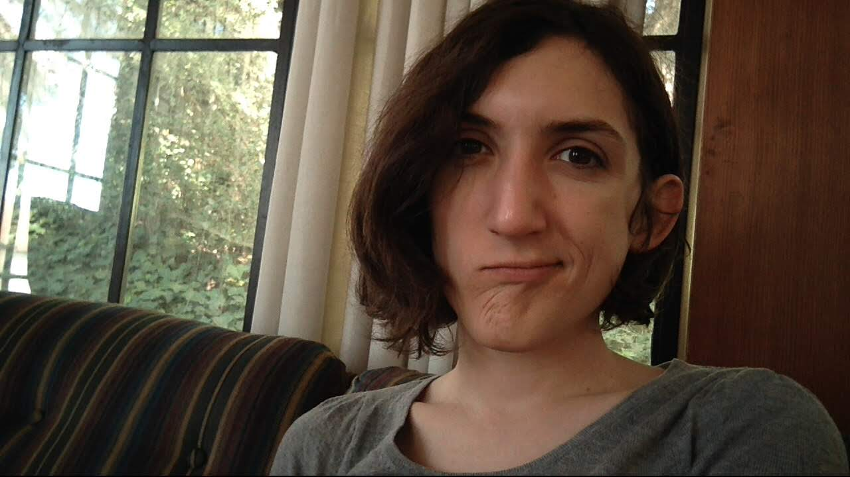


?
?
?
?
?
?

Slide 6
Collaboration is beautiful and hard
Within a collaborative dynamic, some of us are pointy and some of us are round
It’s easy to needle each other, even without knowing it
Highly context dependent
Base assumption: we’re all trying to be good neighbors
But doing so is hard, and takes practice

Slide 7
Ok! So, some hacks:

Slide 8
Use “we”
instead of “you”
1.

Slide 9
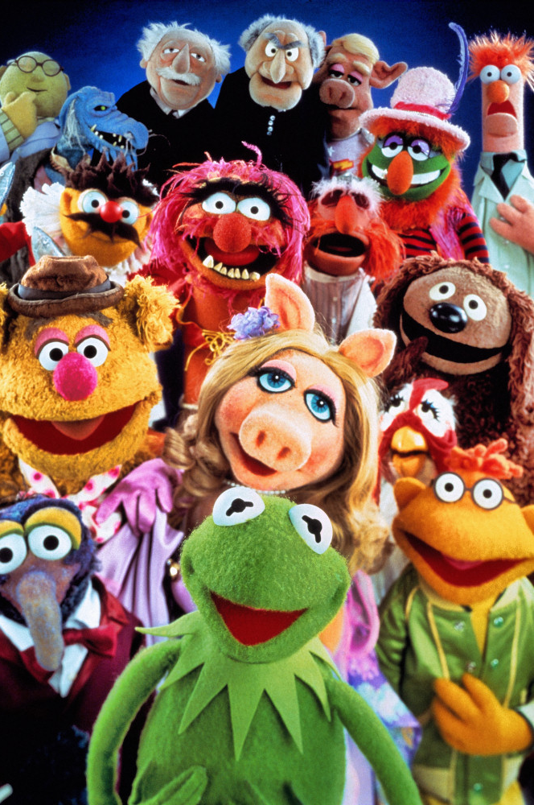
Use “we” instead of “you”
Use collective pronouns to promote a sense of teamwork and shared purpose
Even if it’s really just about stuff one person is going to do
“You need to install scikit-learn with pip” -> “We need to to install scikit-learn with pip”
“Can you open a new tab and search for the docs?” -> “Let’s open a new tab and search for the docs.”

Slide 10
Share softly
2.

Slide 11

Share softly
Working together means we have to ask a lot of questions and offer a lot of suggestions
The art is doing so without making it feel like a PhD qual
?
It can help to:
Shift the subject of questions off of the individual and onto the concept you’re tackling
Avoid absolutes and judgements of triviality
Focus on subjective experience, rather than objective fact

Slide 12
Soft examples
“It’s just a matter of [reading a file] ” “There are a lot of resources to help with [reading a file] ” “ [reading a file] is a problem I know we can tackle”
“Do you know what [Python] is?” “What does [Python] mean to you?” “How familiar are you with [Python]?”
“Does that make sense?” “How do you feel about that?” “Did I explain that well?”
“You should be using [numpy] ” / “ [numpy] is trash” “I’ve had a lot of good experiences with [numpy]” “I’m worried about [numpy] because [I’ve seen it perform poorly with this kind of data] ”

Slide 13
Appreciate the
thought process
3.

Slide 14




Appreciate the thought process
Look for opportunities to identify and positively reinforce each other’s working processes
Every question is a good question
Every idea is worth props
Every obstacle is worth commiserating with
Be specific where possible
Even if it seems too minor or too often, it’s not.
We’re hard on ourselves when learning something new, we can use the validation.

Slide 15



Some of my fave affirmations
“That’s a great question, I think it brings up a really subtle point about [...] “
“Oh I love this! I appreciate how { elegant / effective / on-point / … } it is.”
“Wow that was a ridiculous bug, I’m going to remember that one.”

Slide 16
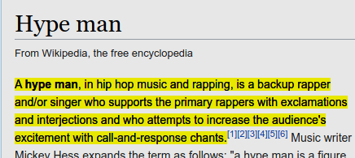
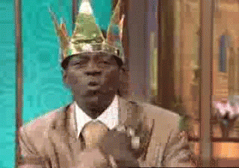
Let’s get excited!

Slide 17
To recap,
Notes:
(eg, go slow)

Slide 18
Use “we” instead of “you”
Share softly
Appreciate the thought process

Slide 19
Use “we” instead of “you”
Share softly
Appreciate the thought process
Remember that experience is subjective

Slide 20
~
Notes:
Draft 1 - 18 min
Draft 2 - 13 min

Slide 21
Remember that experience is subjective
4.
Notes:
(eg, go slow)

Slide 22
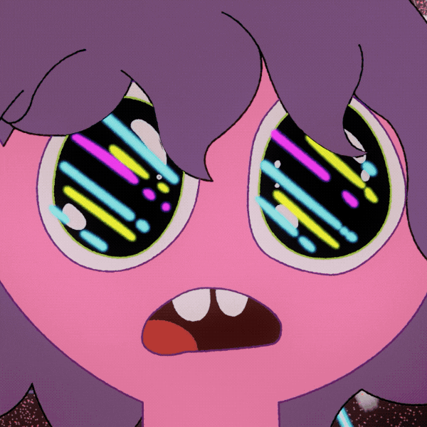
Remember that experience is subjective
Luckily, our teammates’ experience of working with us is largely unrelated to our perception of their experience working with us.
It’s ok to struggle, and ok to feel bad
Regardless of whether you do or not, your teammates want you to succeed

Slide 23
Hackweek Project Team:
Getting Organized
Charley Haley
eScience Institute/Wayforagers.org

Slide 24
Organizing Considerations

Slide 25
What is the best scope for your project?
Exploratory, open-ended, broader in scope
Focused, specific, narrower in scope
Project
Harder to:
Organize & manage
Project Leader may spend more time mentoring & guiding others & less time hacking
Sense the progress being made
However, it’s great opportunity to advance something bigger, personally meaningful, longer-duration
Easier to:
Identify tasks & skills needed
Distribute tasks across team
Organize & manage
Know when a task is complete
Have a sense of success & completion

Slide 26
How will we work on tasks given our mix of knowledge & various levels of skillfulness?
Autonomous Coding
Paired Coding
Coaching/Co-Mentoring
Skilled
Skilled
Skilled
Novice
Novice
Skilled
Novice

Slide 27




When working on your project team, what do you personally need to experience for this time to be a satisfying success? What supports & motivates your learning?
Completing tasks/project
Place the smiley inside the triangle to indicate your learning & development sweet spot
Working out challenges & tasks on my own
Peer learning, co-mentoring, working together
Notes:
How do you learn best? What motivates your learning?

Slide 28
Getting Started on Your Project Team
Find the best scope for your project and goals, then list out the tasks and skills needed
This part is messy and hard, so don’t be shy about reaching out to a hackweek data scientist to help clarify & shape this part
Invite team to indicate the tasks they’re attracted to and their skill-level
On the next slide, invite the team to show where their learning & development sweet spot is inside the triangle
Remember, be “selfish” about what you want to experience during this hackweek, ask for what you need

Slide 29
When working on your project team, what do you personally need to experience for this time to be a satisfying success? What motivates your learning?
Place your smiley inside the triangle to indicate your learning & development sweet spot
Completing tasks/project
your name
your name
your name
your name
your name
your name
your name
your name
your name
Working out challenges & tasks on my own
Peer learning, co-mentoring, working together
Notes:
How do you learn best? What motivates your learning?

Slide 30
Getting Started on Your Project Team (cont.)
Chat about the pattern/distribution you see in the triangle
How well do our learning preferences/needs map to the tasks to be done?
Do we see any skills gaps that will need to be worked out w/ data scientist helper?
Given what we know now about the project/tasks, would anyone like to look for another project? If so, no worries, the data scientist helper can help with that. Just reach out in #hackweek-help- or in a private DM to Anthony
Pin down logistics
Who’s doing what?
What is everyone’s availability to hack (alone &/or together)?
How will we coordinate and communicate with each other?
Start hacking!

Slide 31
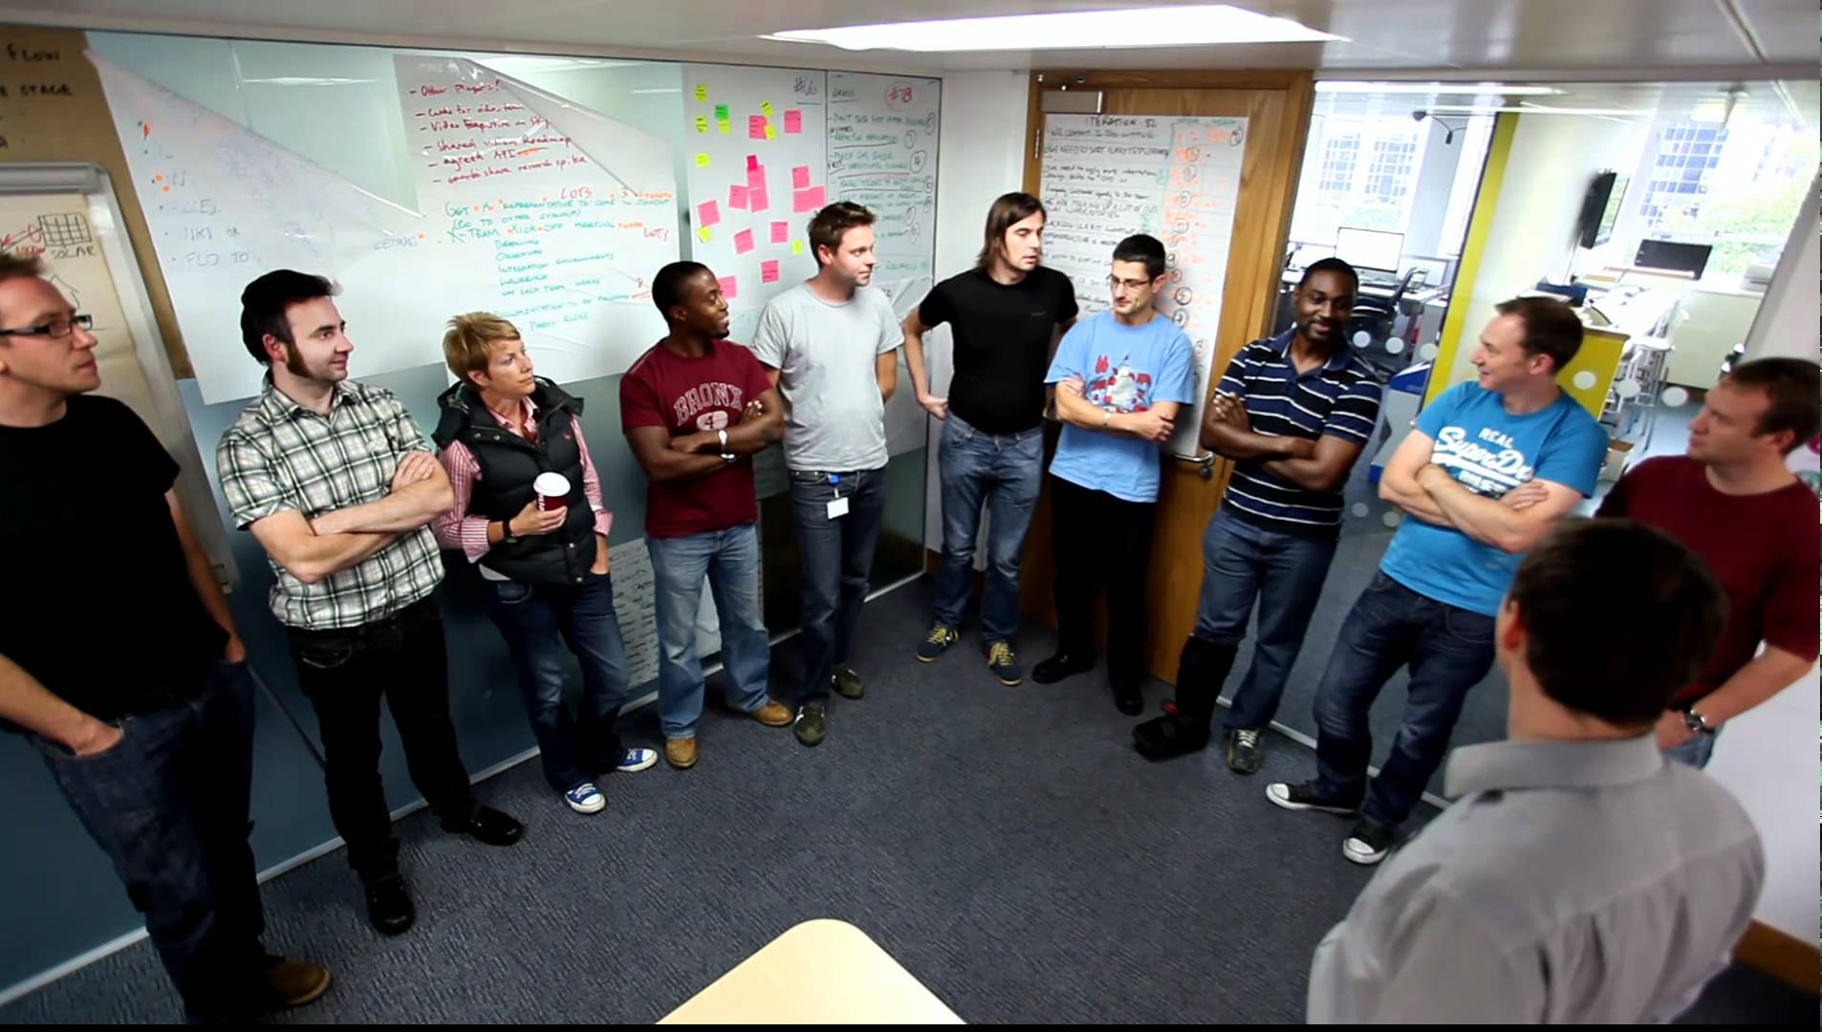
Daily Huddle: Briefly connect, coordinate, & get/give help
What I’m working on that's going well ...
What I plan to do/learn next ...
Steps (~ 15-ish min.):
Coordinate a time & place to meet each day
Everyone takes ~2 min to check-in around 3 areas
Project lead coordinates help & coaching
Something that's slowing me down that I'd like help with ...

